Slide 1
Computer Vision and Deep Learning
Lecture 9

Slide 2
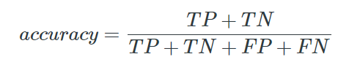
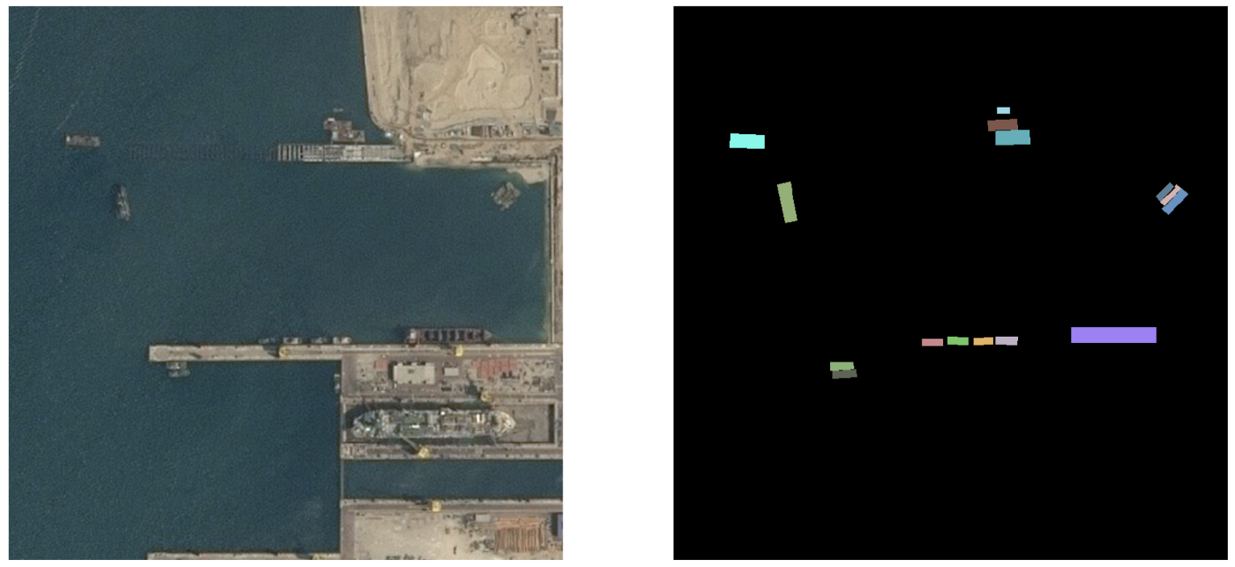

Semantic segmentation metrics
Pixel accuracy
Number of pixels classified correctly by the network
Image
Ground truth
Prediction ☹
Accuracy 95%

Slide 3
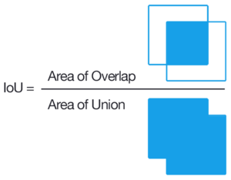
Semantic segmentation metrics
Intersection over Union
Mean IOU 47.5%
https://towardsdatascience.com/metrics-to-evaluate-your-semantic-segmentation-model-6bcb99639aa2
Prediction ☹

Slide 4
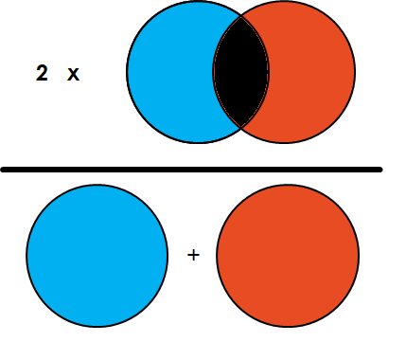
Semantic segmentation metrics
Dice Coefficient
Dice score 47.5%
https://towardsdatascience.com/metrics-to-evaluate-your-semantic-segmentation-model-6bcb99639aa2
Prediction ☹

Slide 5
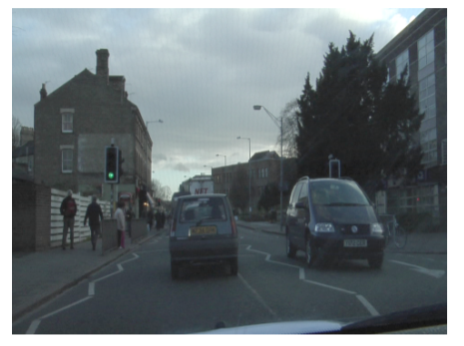


Semantic segmentation Examples
Autonomous driving

Slide 6
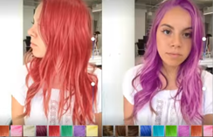
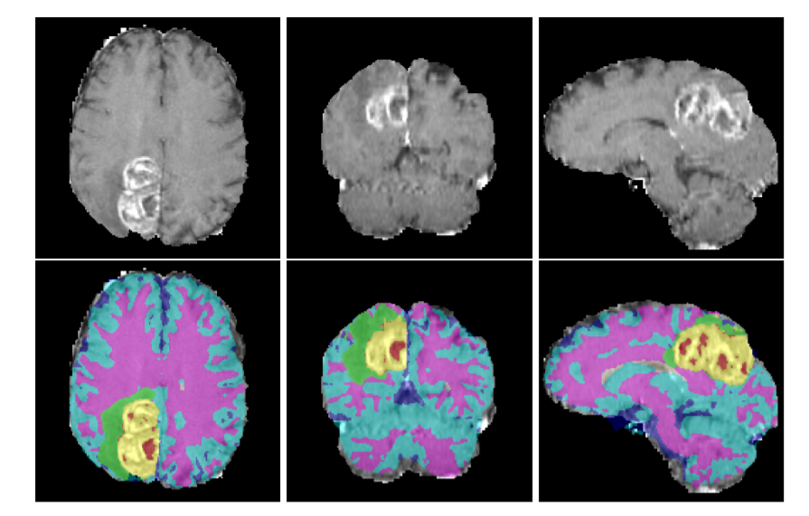
Semantic segmentation Examples
Medical image segmentation
https://arxiv.org/pdf/1810.05732.pdf
Real time hair colouring
https://news.developer.nvidia.com/3d-real-time-video-hair-coloration/

Slide 7
Long, Jonathan, Evan Shelhamer, and Trevor Darrell. "Fully convolutional networks for semantic segmentation." Proceedings of the IEEE conference on computer vision and pattern recognition. 2015.
Ronneberger, Olaf, Philipp Fischer, and Thomas Brox. "U-net: Convolutional networks for biomedical image segmentation." International Conference on Medical image computing and computer-assisted intervention. Springer, Cham, 2015.
Jégou, Simon, et al. "The one hundred layers tiramisu: Fully convolutional densenets for semantic segmentation." Proceedings of the IEEE conference on computer vision and pattern recognition workshops. 2017.
https://beyondminds.ai/a-simple-guide-to-semantic-segmentation/

Slide 8
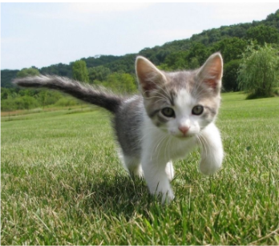
Object localization
What object is this image and where is this object located in the image?
CAT

Slide 9
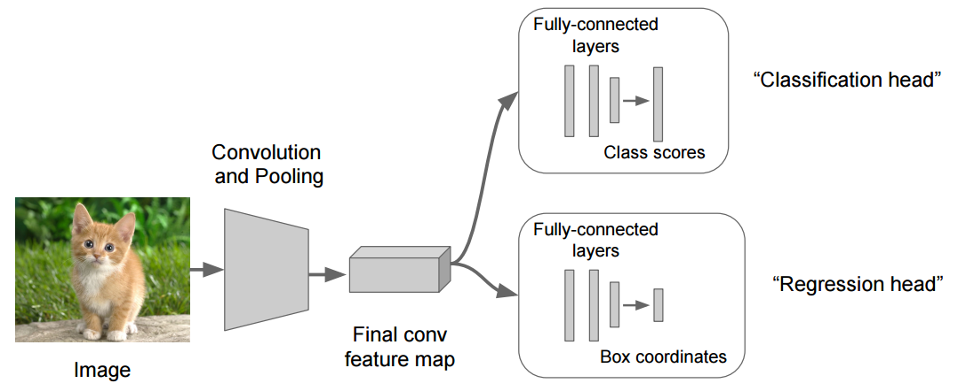
Object localization
Image source: https://leonardoaraujosantos.gitbook.io/artificial-inteligence/machine_learning/deep_learning/object_localization_and_detection

Slide 10
Object localization
C class scores
Softmax loss L_{s}
BBOX coordinates
4 outputs (x, y, w , h)
L2 loss L₂
Image source: https://leonardoaraujosantos.gitbook.io/artificial-inteligence/machine_learning/deep_learning/object_localization_and_detection

Slide 11
Object detection
Determine the class (label) and the position of EACH object in the input image
We can’t use the same approach as for localization
Each image would require a different number of outputs
Sliding window approach?

Slide 12
Object detection without proposals

Slide 13
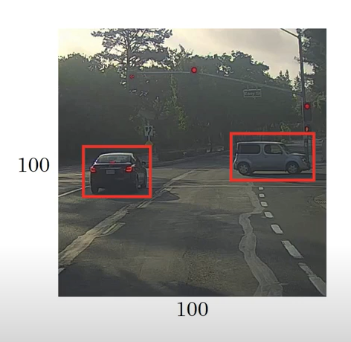

Slide 14
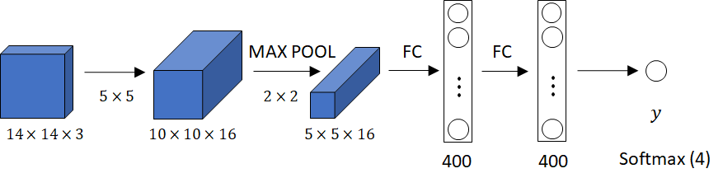
Convolutional implementation of sliding windows
https://www.youtube.com/watch?v=XdsmlBGOK-k
Example credit Andrew Ng

Slide 15
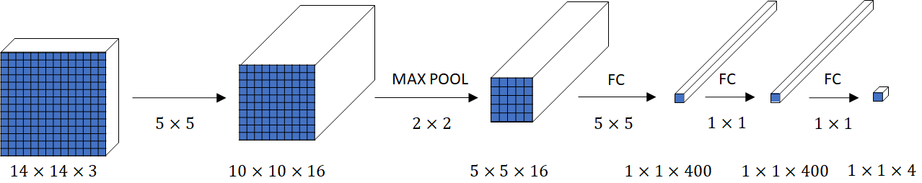
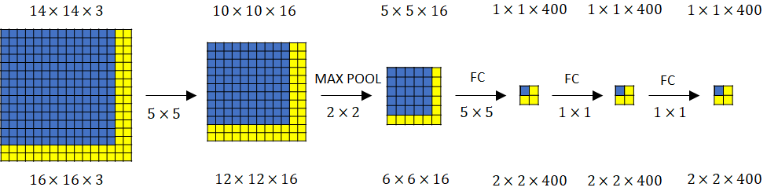
Convolutional implementation of sliding windows
https://www.youtube.com/watch?v=XdsmlBGOK-k
Example credit Andrew Ng

Slide 16
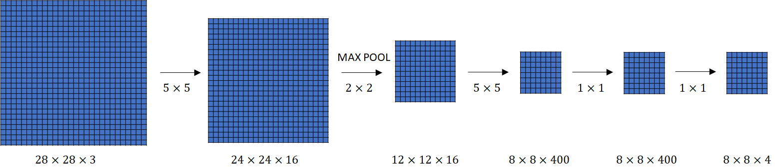
Convolutional implementation of sliding windows
https://www.youtube.com/watch?v=XdsmlBGOK-k
Example credit Andrew Ng

Slide 17
YOLO You only look once
Detection is modelled as a regression problem
image is divided into an S × S grid
for each grid cell predict:
B bounding boxes
confidence for those boxes,
C class probas

Slide 18
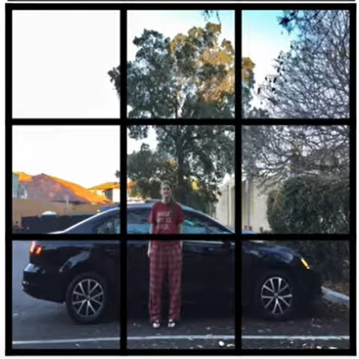
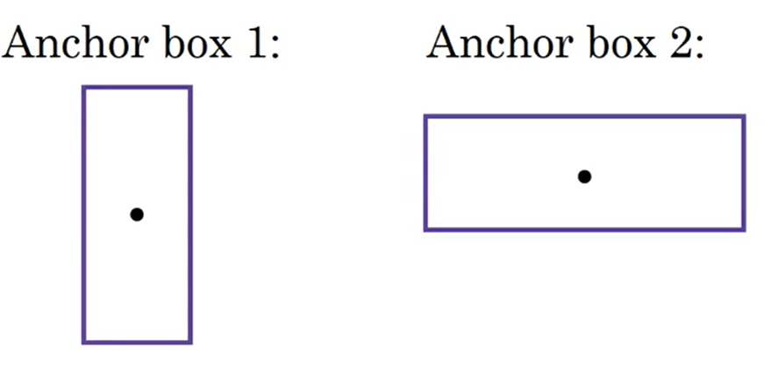
YOLO Anchor boxes
Allows the object detector to specialize better (detect “thinner” or “wider” objects)
https://www.youtube.com/watch?v=RTlwl2bv0Tg

Slide 19
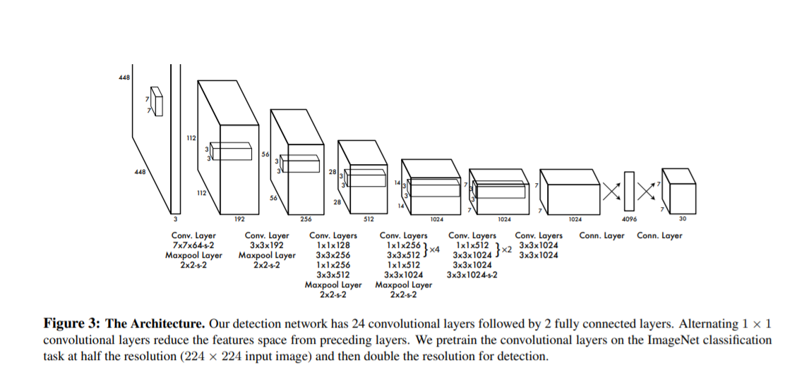
For evaluating YOLO on PASCAL VOC, we use S = 7, B = 2. PASCAL VOC has 20 labelled classes so C = 20. Our final prediction is a 7 × 7 × 30 tensor

Slide 20
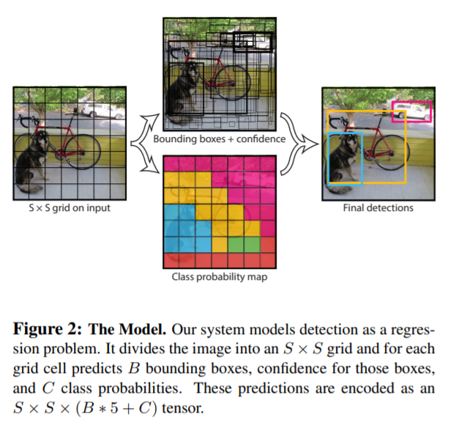

Slide 21
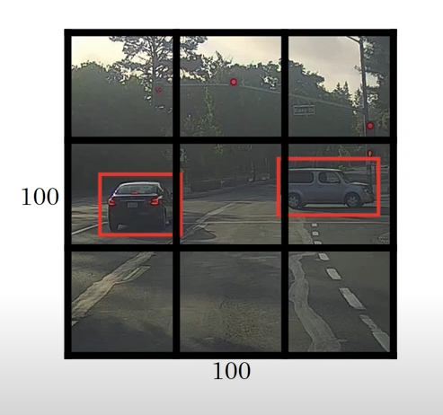

Slide 22
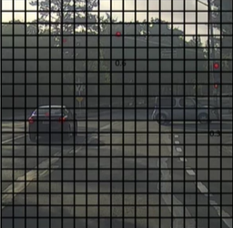
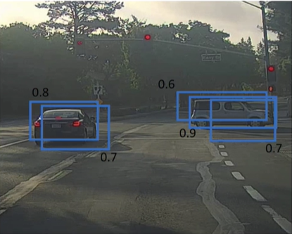
YOLO Non maximum suppression
Discard all predictions with proba <= threshold
while there are any remaining boxes
Select the box with the largest proba (maxBB) as a prediction
Discard boxes with IoU >= 0.5 with maxBB
https://www.youtube.com/watch?v=VAo84c1hQX8

Slide 23
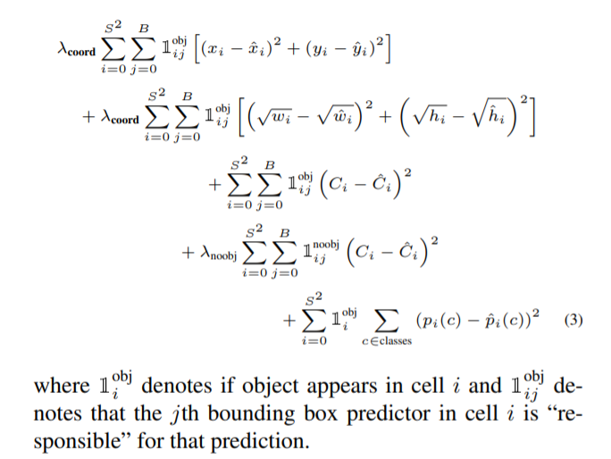
YOLO Loss function
This is the loss function for yolo v1 paper.
Here each bounding box predicts an objectness score and a 4 coordinates, but the class predictions are per cell. Hence this:

Slide 24
Proposal based object detection

Slide 25
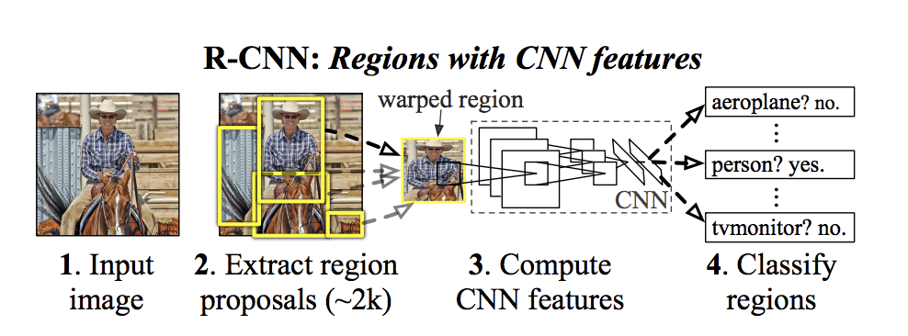
R-CNN Region-based Convolutional Network, 2014
Idea:
Use an algorithm (or network) to find region of interests (ROIs) that are likely to contain an object
Localize (label + bounding box) localize the object in each in region
https://arxiv.org/pdf/1311.2524.pdf

Slide 26
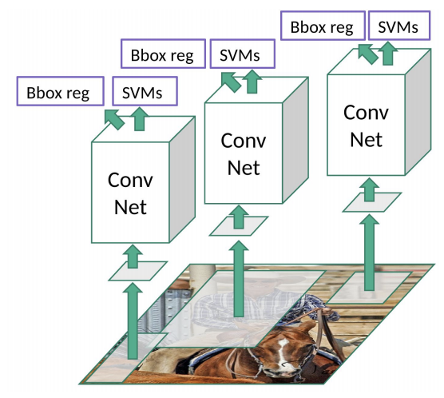
R-CNN Region-based Convolutional Network, 2014
Selective search to extract 2000 regions. NO learning here
Image source: https://towardsdatascience.com/r-cnn-fast-r-cnn-faster-r-cnn-yolo-object-detection-algorithms-36d53571365e

Slide 27
R-CNN Region-based Convolutional Network, 2014
Warp each image region into a square of 227x227 ROI (will be fed to AlexNet) + 16 pix
Selective search to extract 2000 regions. NO learning here
Image source: https://towardsdatascience.com/r-cnn-fast-r-cnn-faster-r-cnn-yolo-object-detection-algorithms-36d53571365e

Slide 28
R-CNN Region-based Convolutional Network, 2014
AlexNet – feature extractor
Warp each image region into a square of 227x227 ROI (will be fed to AlexNet)
Selective search to extract 2000 regions. NO learning here
Image source: https://towardsdatascience.com/r-cnn-fast-r-cnn-faster-r-cnn-yolo-object-detection-algorithms-36d53571365e

Slide 29
R-CNN Region-based Convolutional Network, 2014
SVMs to classify the presence + label of an object in region
Regression to fine tune the bounding boxes
AlexNet – feature extractor
Warp each image region into a square of 227x227 ROI (will be fed to AlexNet)
Selective search to extract 2000 regions. NO learning here
Image source: https://towardsdatascience.com/r-cnn-fast-r-cnn-faster-r-cnn-yolo-object-detection-algorithms-36d53571365e

Slide 30
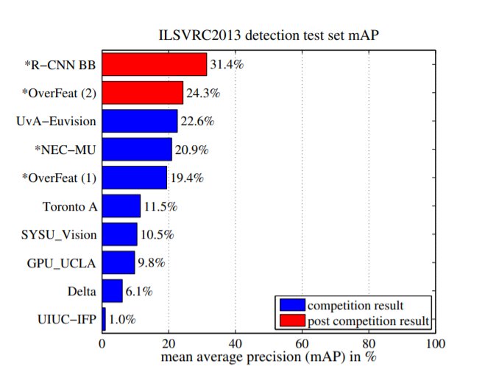
R-CNN
Running time: “13s/image on a GPU or 53s/image on a CPU”

Slide 31
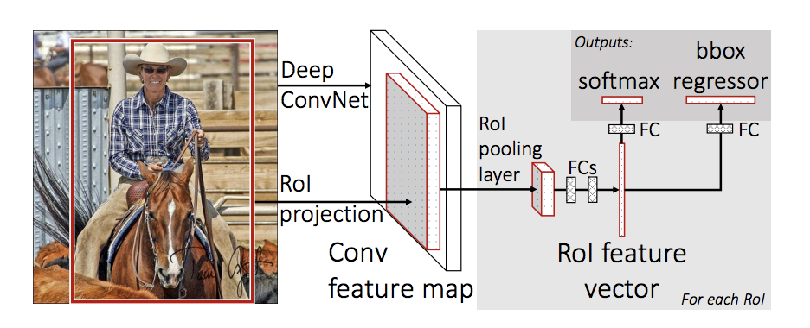
Fast RCNN
Idea: feed to image only once to the CNN to extract a feature map, then crop and warp regions of this feature map

Slide 32
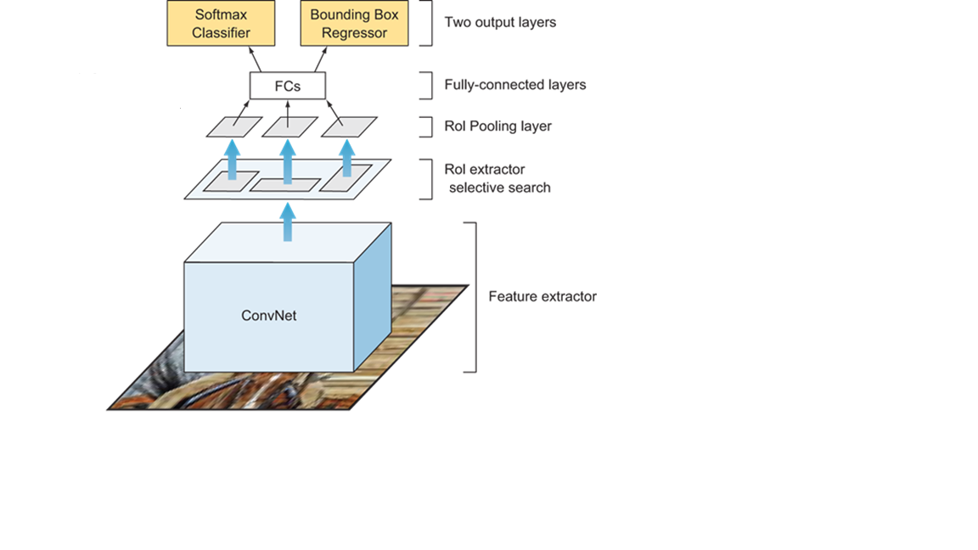
Fast R-CNN
Feed the ENTIRE image only once though the CONV net

Slide 33
Fast R-CNN
Extract the ROIs (proposed by selective search) at feature map level using RoI Pooling

Slide 34
Fast R-CNN
N classes + background
Bounding boxes
(x, y, w, h)
Extract the ROIs (proposed by selective search) at feature map level using RoI Pooling
Feed the ENTIRE image only once though the CONV net

Slide 35
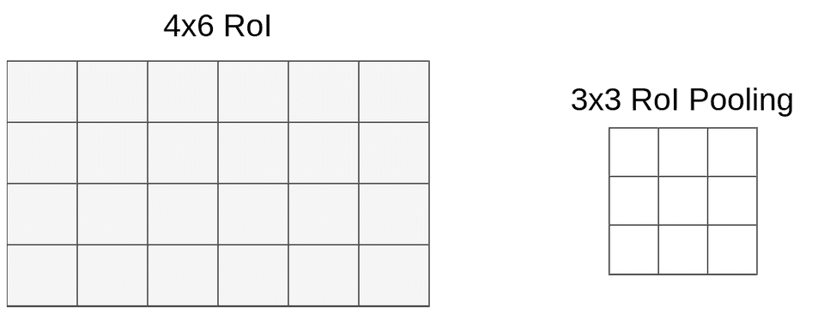
Roi Pooling
Divide the H × W ROI window into an h × w grid of sub-windows of approximate size H/h × W/w and then max-pooling the values in each sub-window into the corresponding output grid cell.

Slide 36
Roi Pooling
W = 6, H = 4
w = 3, h = 3
sz_w = 6/3=2, sz_h=4/3 = 1

Slide 37
Roi Pooling
W = 6, H = 4
w = 3, h = 3
sz_w = 6/3=2, sz_h=4/3 = 1
Apply max pooling in each ROI

Slide 38
Roi Pooling
W = 6, H = 4
w = 3, h = 3
sz_w = 6/3=2, sz_h=4/3 = 1
Apply max pooling in each ROI

Slide 39
ROI Pooling example
https://towardsdatascience.com/understanding-region-of-interest-part-2-roi-align-and-roi-warp-f795196fc193
https://towardsdatascience.com/understanding-region-of-interest-part-1-roi-pooling-e4f5dd65bb44

Slide 40
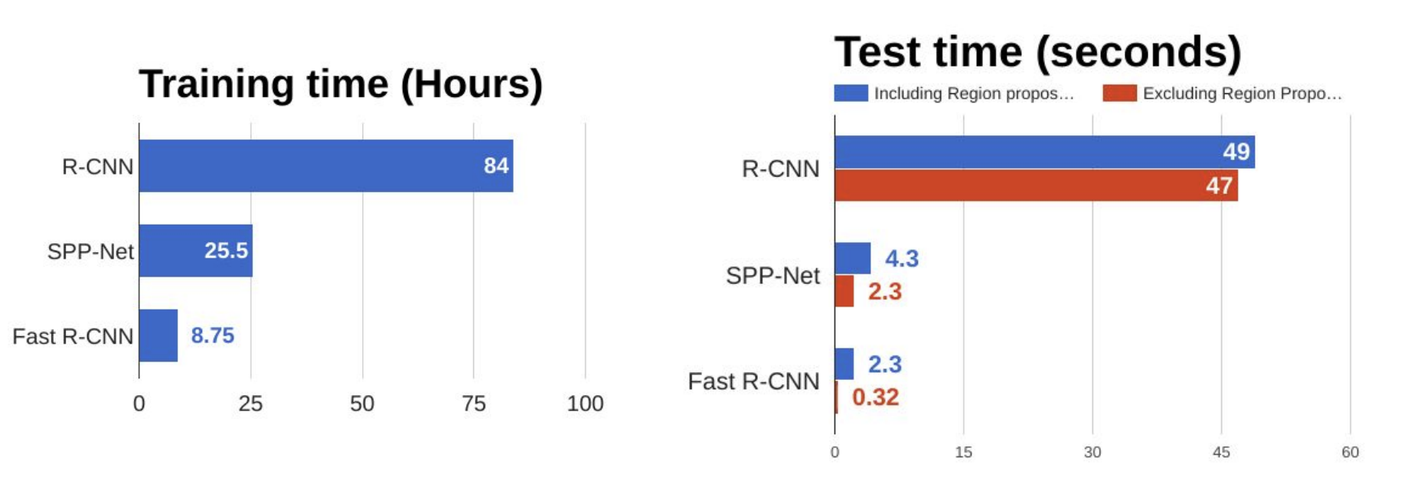
Fast RCNN
What is the most time consuming part of Fast RCNN?

Slide 41
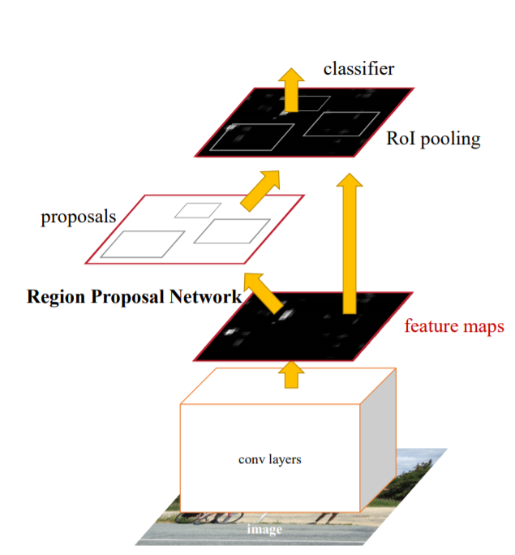
Faster-RCNN
Unified framework for object detection
The rest of the network is similar to Fast RCNN: use ROI pooling to crop feature maps and classify each region
Region proposal network:
replaces selective search and predicts regions directly from feature maps

Slide 42
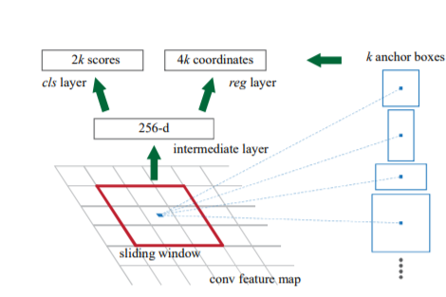
Region proposal network
takes an image (of any size) as input and outputs a set of rectangular object proposals, each with an objectness score
An anchor box of fixed size at each point in the feature map
For each anchor box predict if there is an object inside it
For “positives” predict corrections for the bounding boxes

Slide 43
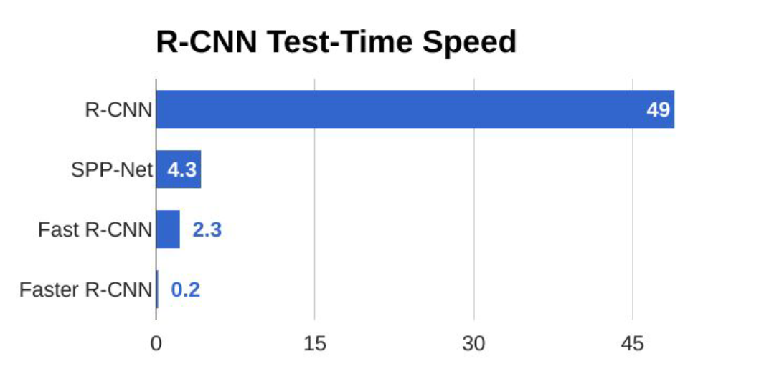

Slide 44
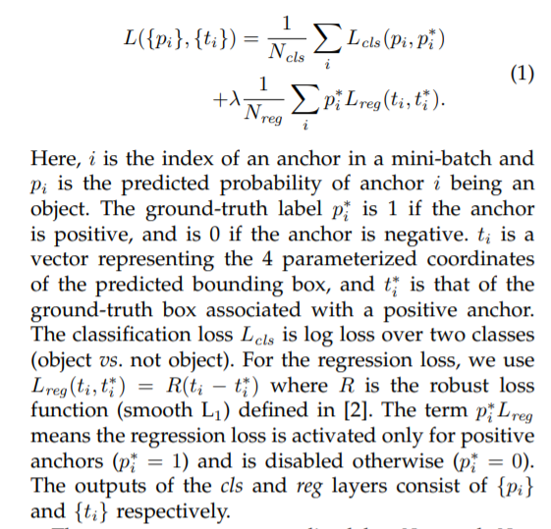
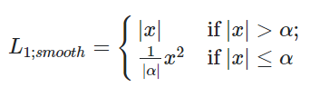
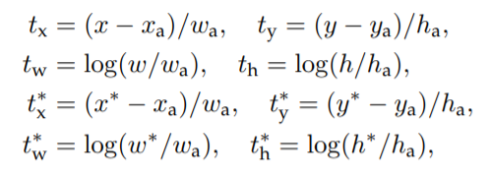
Faster RCNN Loss
t* - ground truth
t –prediction
h_{a} , w_{a} – anchor box
bounding-box regression from an anchor box to a nearby ground-truth box.

Slide 45
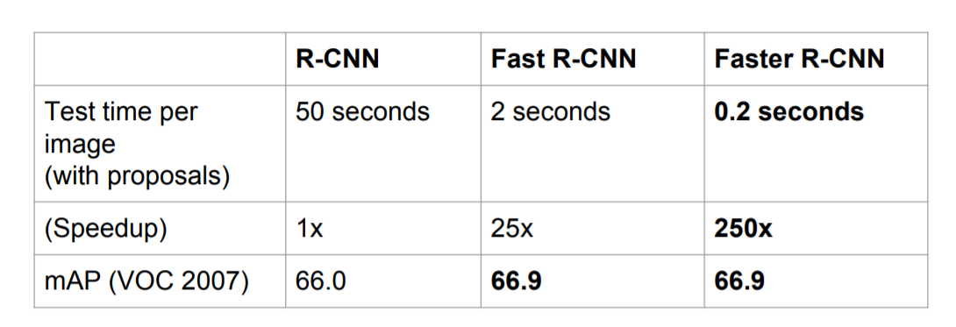

Slide 46
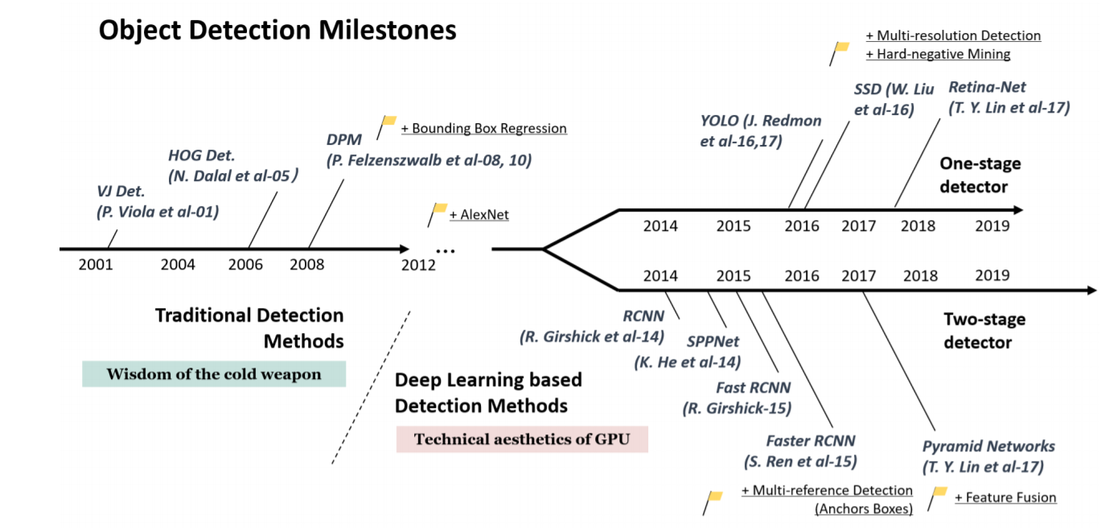
Object detectors
Object Detection in 20 Years: A Survey

Slide 47
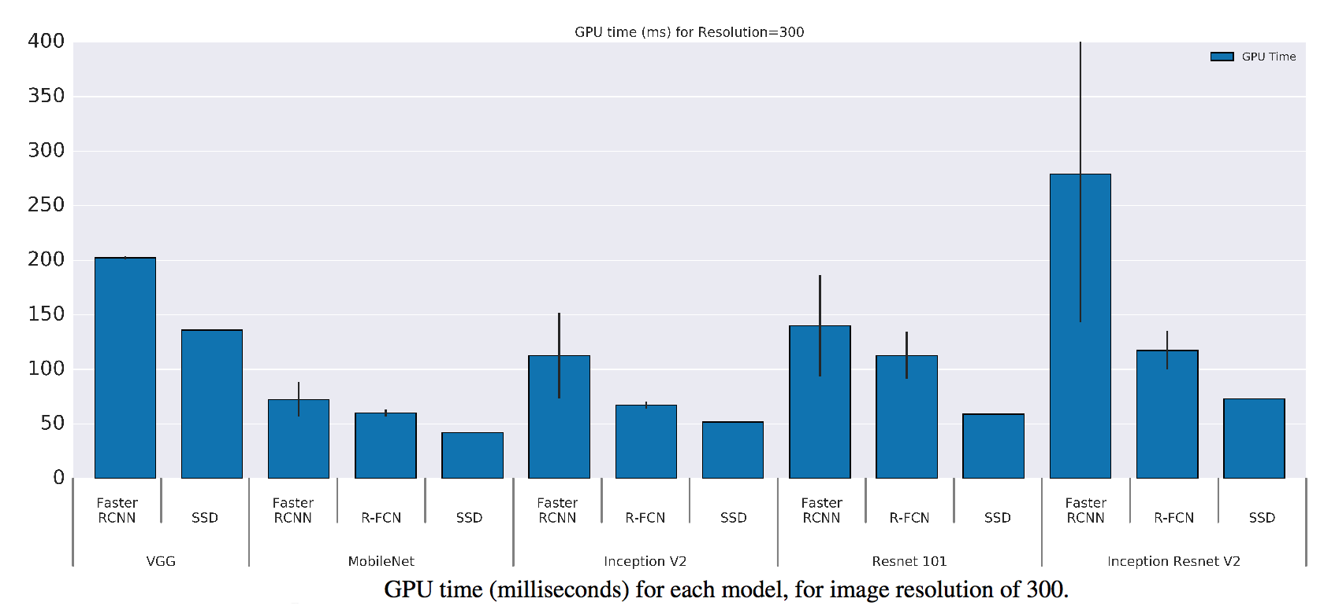
Object detectors
https://jonathan-hui.medium.com/object-detection-speed-and-accuracy-comparison-faster-r-cnn-r-fcn-ssd-and-yolo-5425656ae359

Slide 48
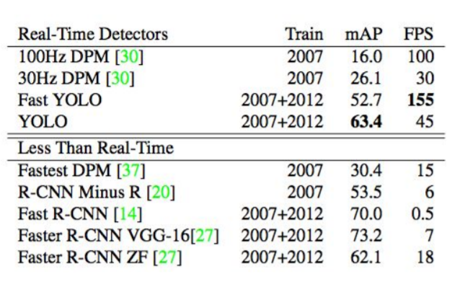

Slide 49
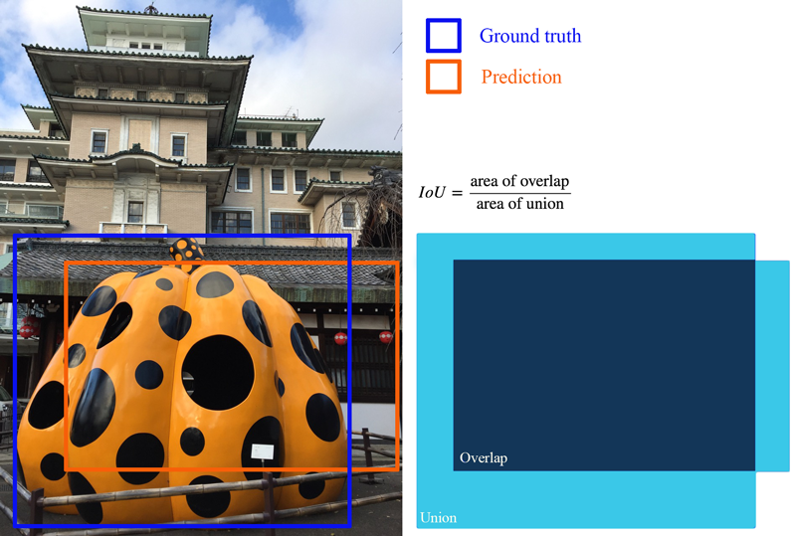
Evaluation metrics for object detection
Use IOU to determine is the object is a TP, FP, or a FN
Remember precision and recall?
Images and notes from: https://jonathan-hui.medium.com/map-mean-average-precision-for-object-detection-45c121a31173

Slide 50
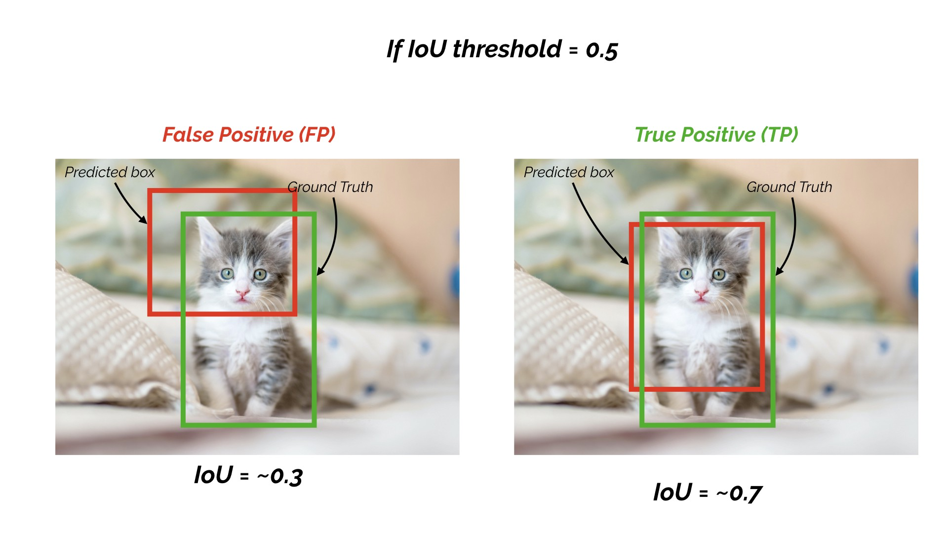

Slide 51
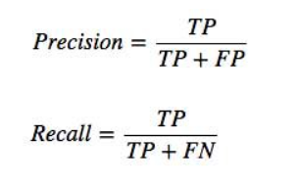
Evaluation metrics for object detection
Use IOU and a threshold to determine is the object is a TP, FP, or a FN
Remember precision and recall?
Images and notes from: https://jonathan-hui.medium.com/map-mean-average-precision-for-object-detection-45c121a31173

Slide 52
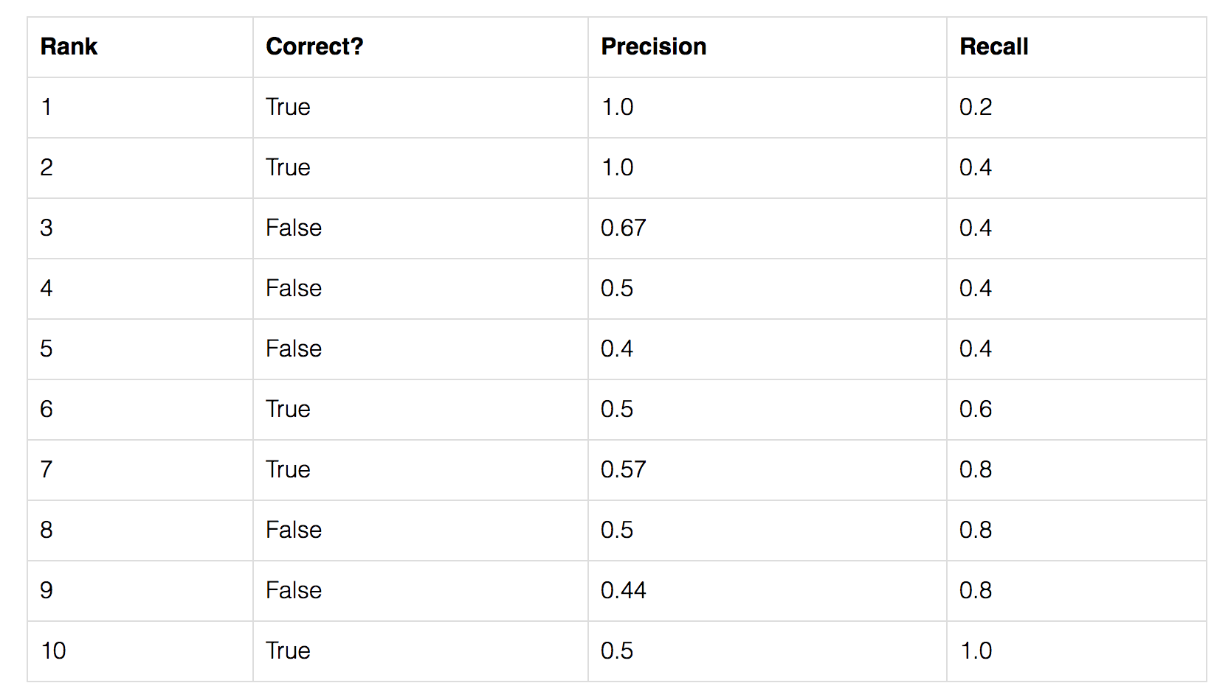
Evaluation metrics for object detection AP
Average Precision (AP) is finding the area under the precision-recall curve.
confidence
Images and notes from: https://jonathan-hui.medium.com/map-mean-average-precision-for-object-detection-45c121a31173

Slide 53
Evaluation metrics for object detection
TP?
FP?
FN?
Precision?
Recall?
Images and notes from: https://jonathan-hui.medium.com/map-mean-average-precision-for-object-detection-45c121a31173

